Slide 1
Creating Infographics
Irene Kitsara
IP Information Officer, Access to Information and Knowledge Division

Slide 2
Sharing your Patent Landscape Report
Email to client/identified potential users
Hard copy
Launching event/meeting
Presentation of the report in various scientific symposia/conferences
Press release
Social media (FB, Twitter, LinkedIn)
Challenges:
Appealing format with competitive edge
Conveying messages in a cost-effective and meaningful manner

Slide 3
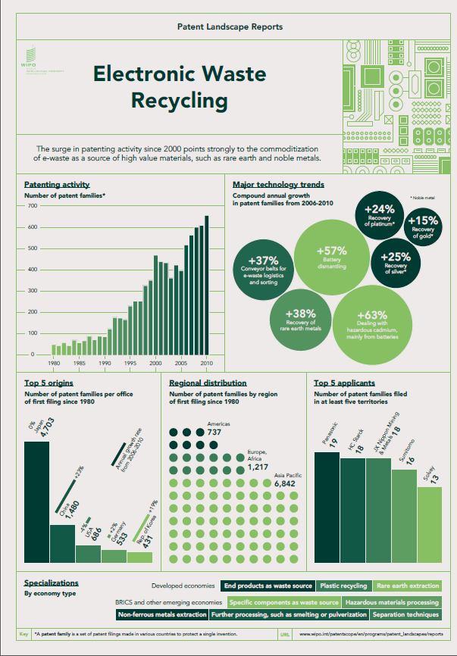
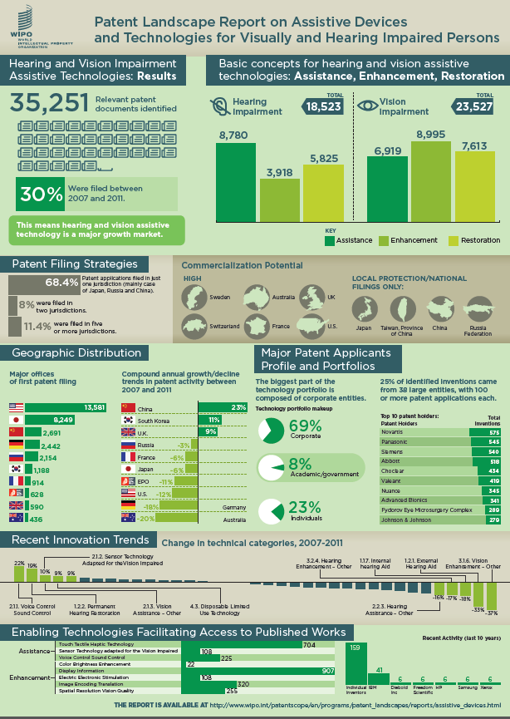
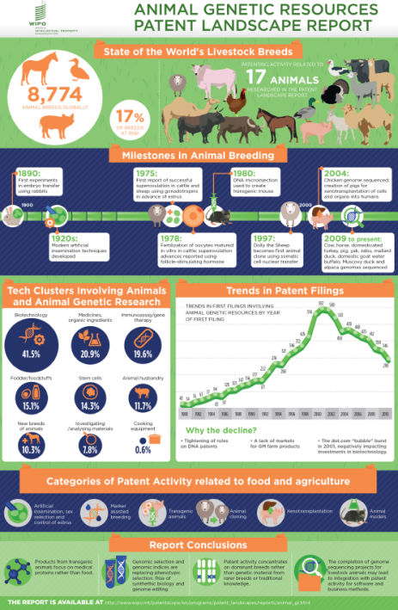
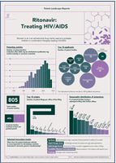
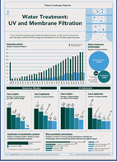

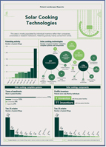
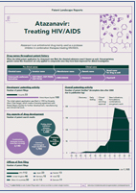
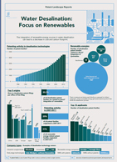
Infographics
Effective means of disseminating - overview of key findings

Slide 4
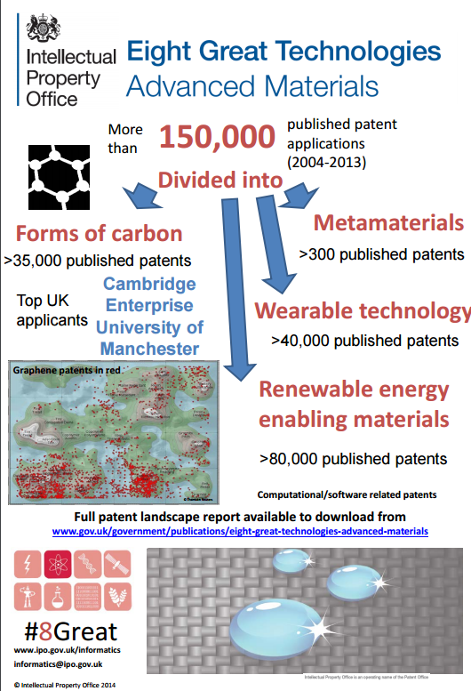

UK IPO Example

Slide 5
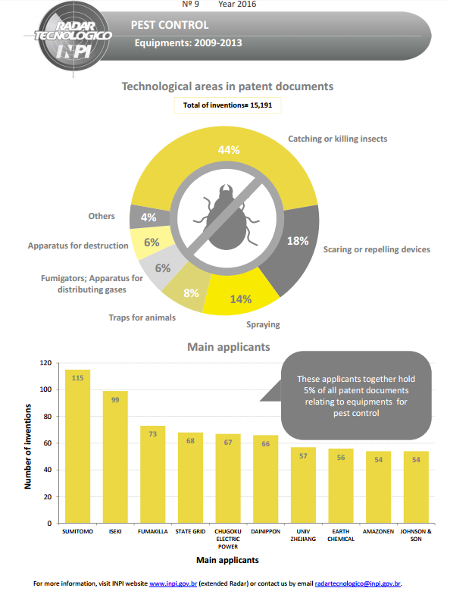
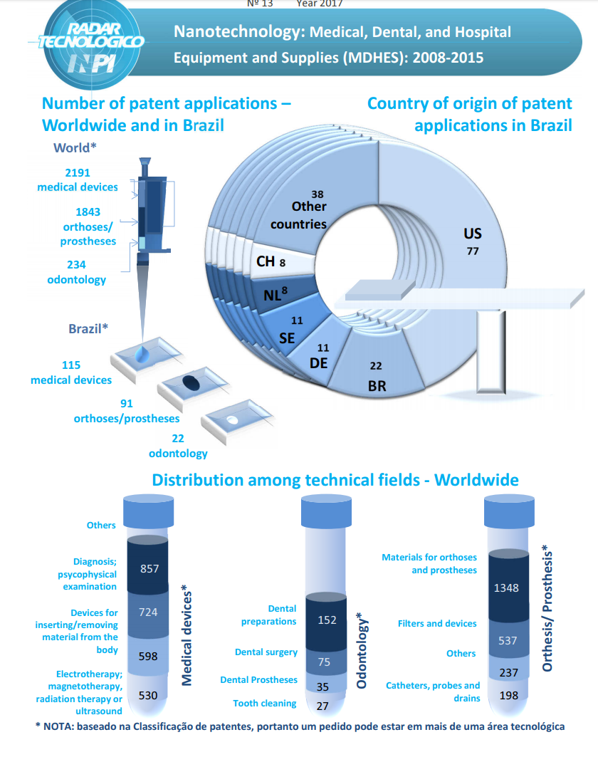
“Technology Radar” (INPI Brazil) – Infographic Element

Slide 6
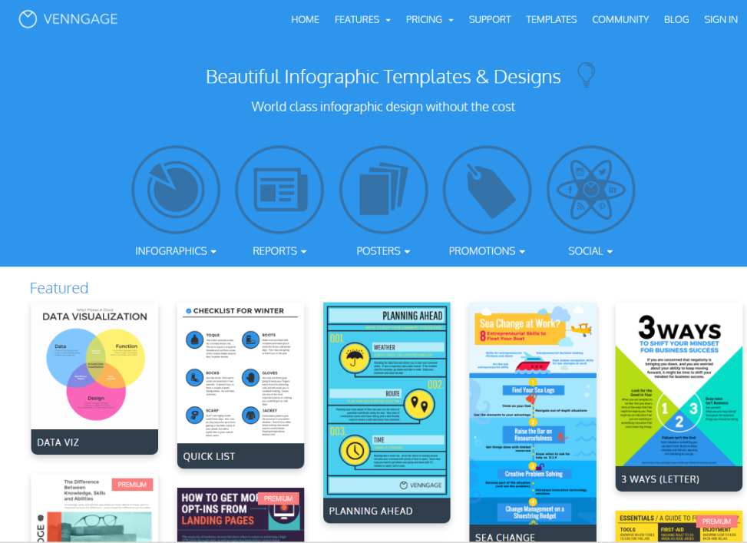
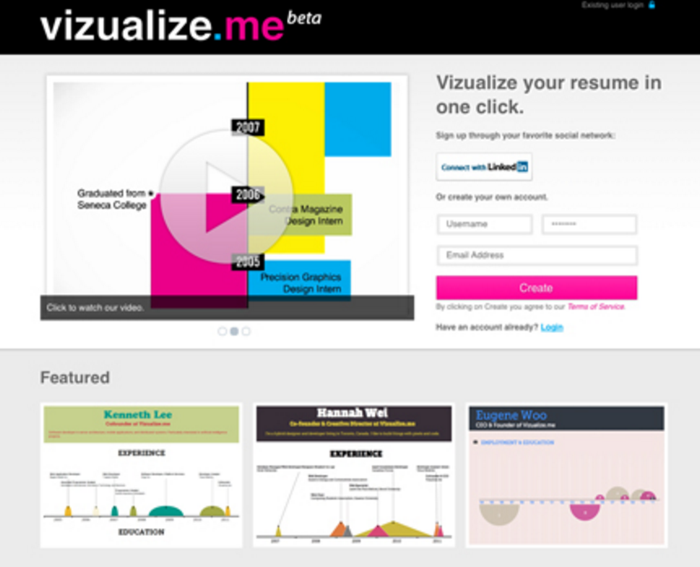
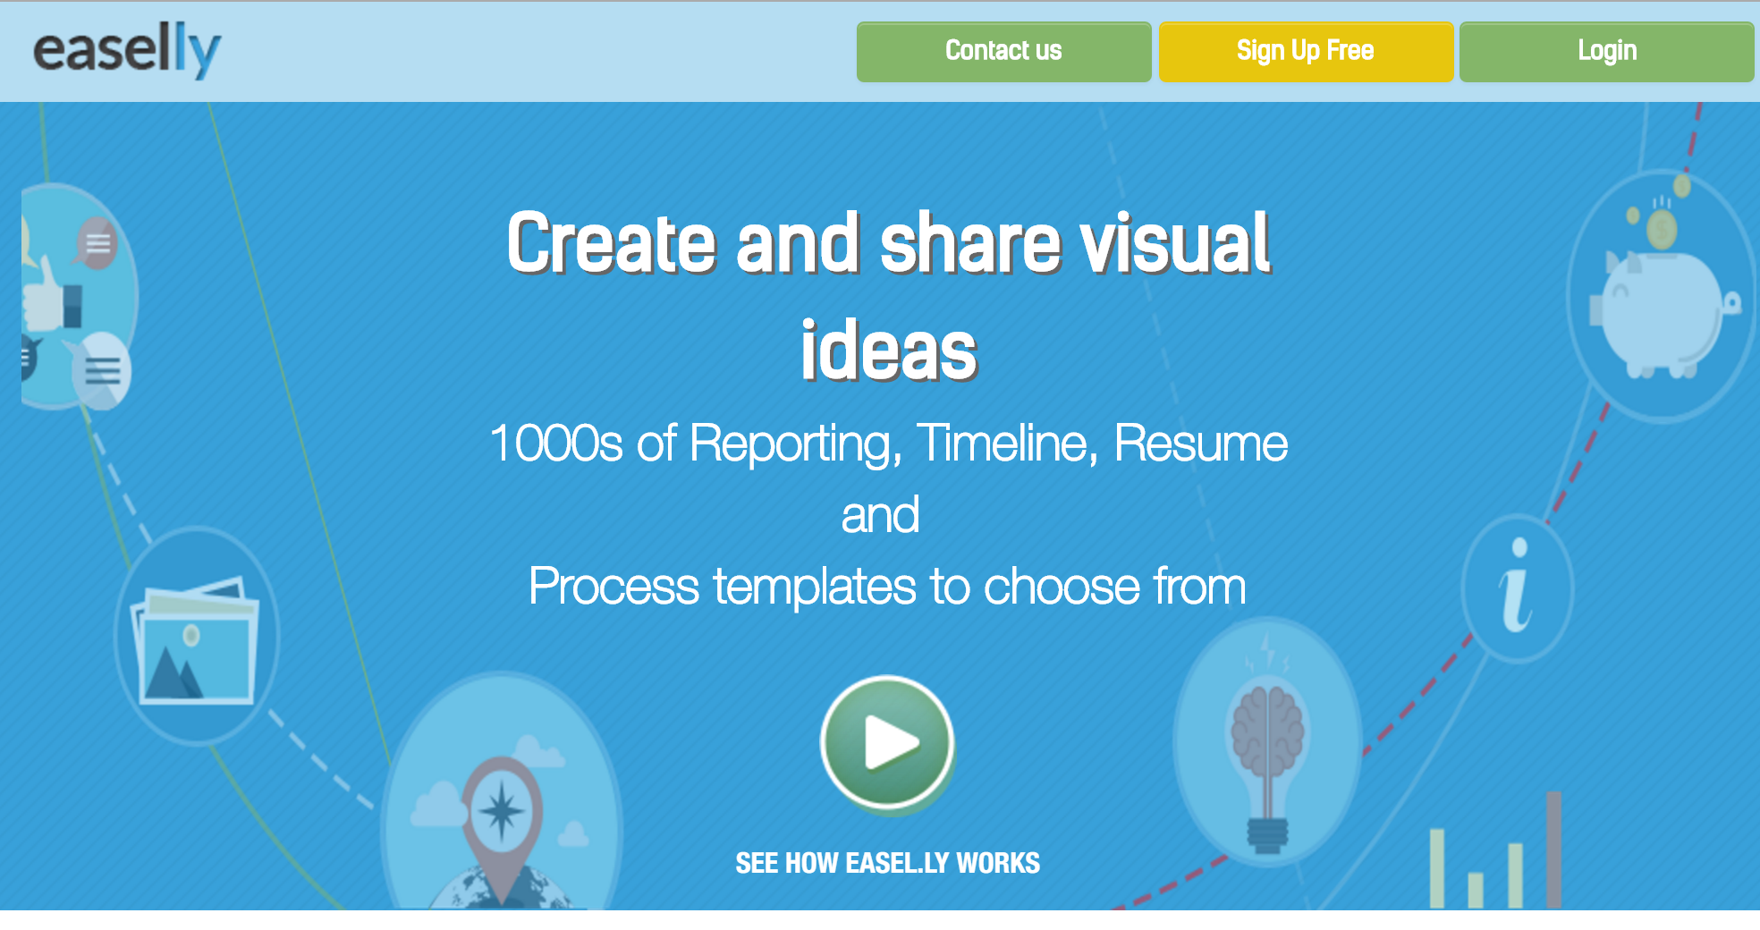

Software for creating Infographics
Info

Slide 7

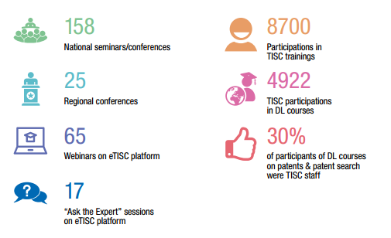
Creating Infographic or using Infographic elements in your reports
www.wipo.int/tisc

Slide 8
Creating an infographic with infogr.am

Slide 9
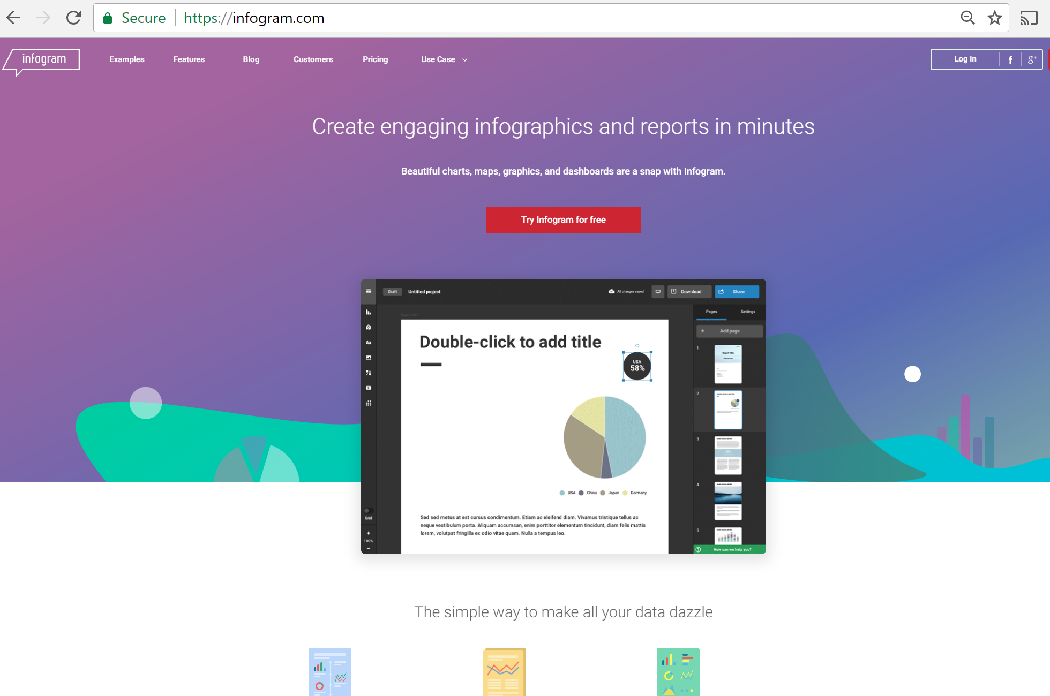
1st step: Create a free account
https://infogr.am

Slide 10

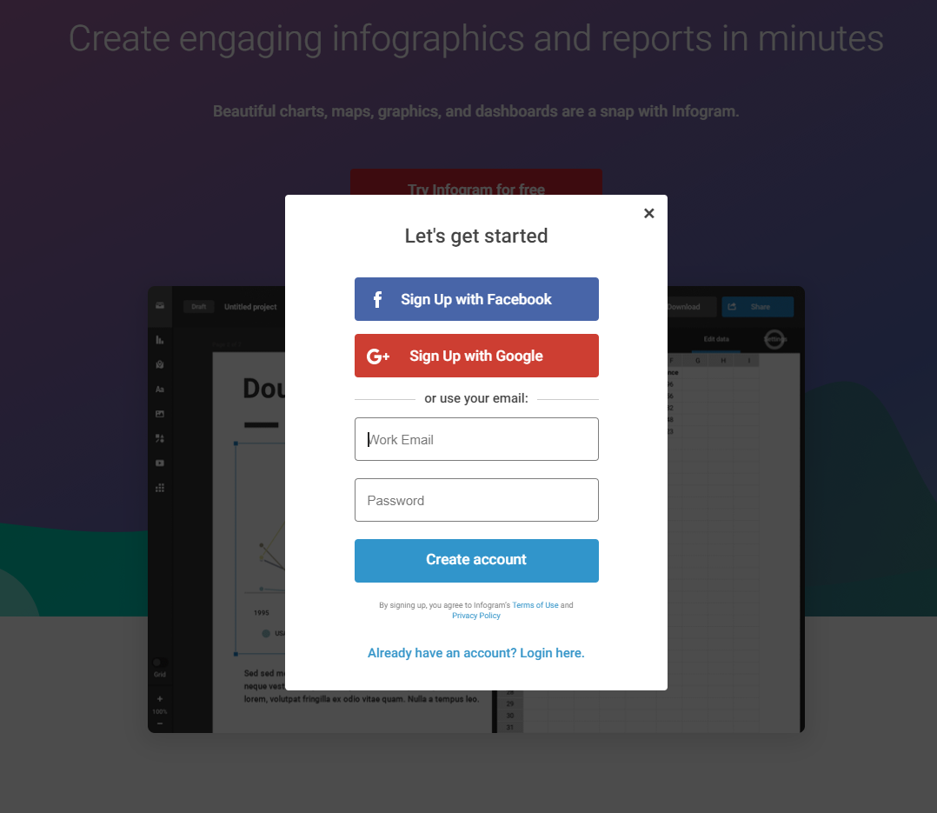
https://Infogr.am –

Slide 11
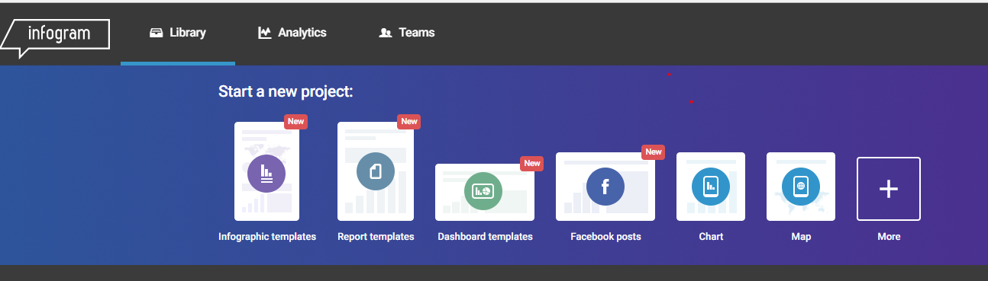
When you are logged in….

Slide 12
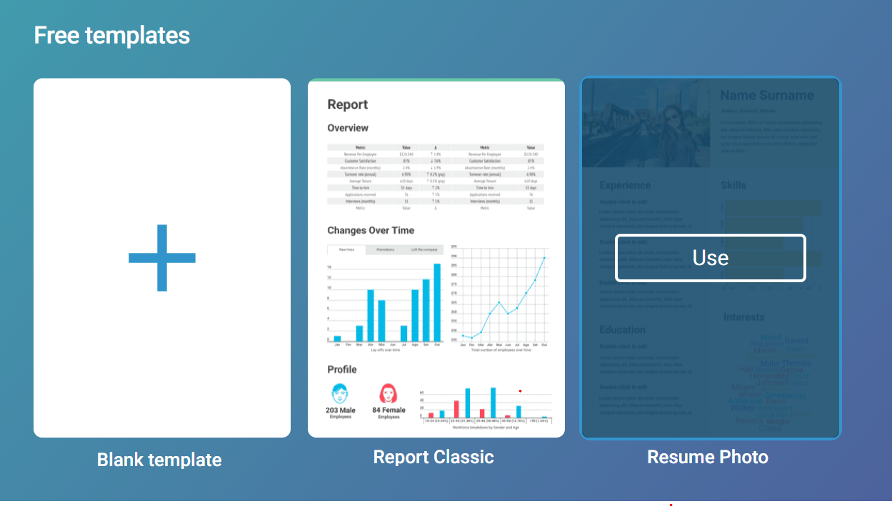
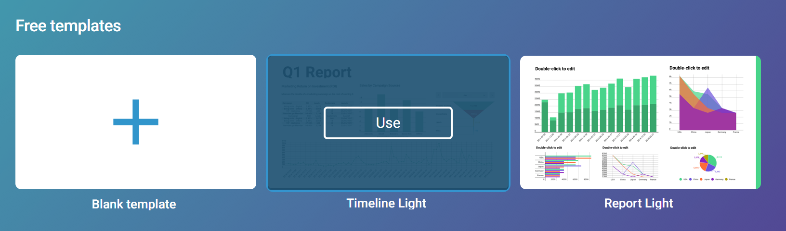
Choose one of the free themes
Reports
Allow you to freely add objects on the canvas. Fixed
Dashboards

Slide 13
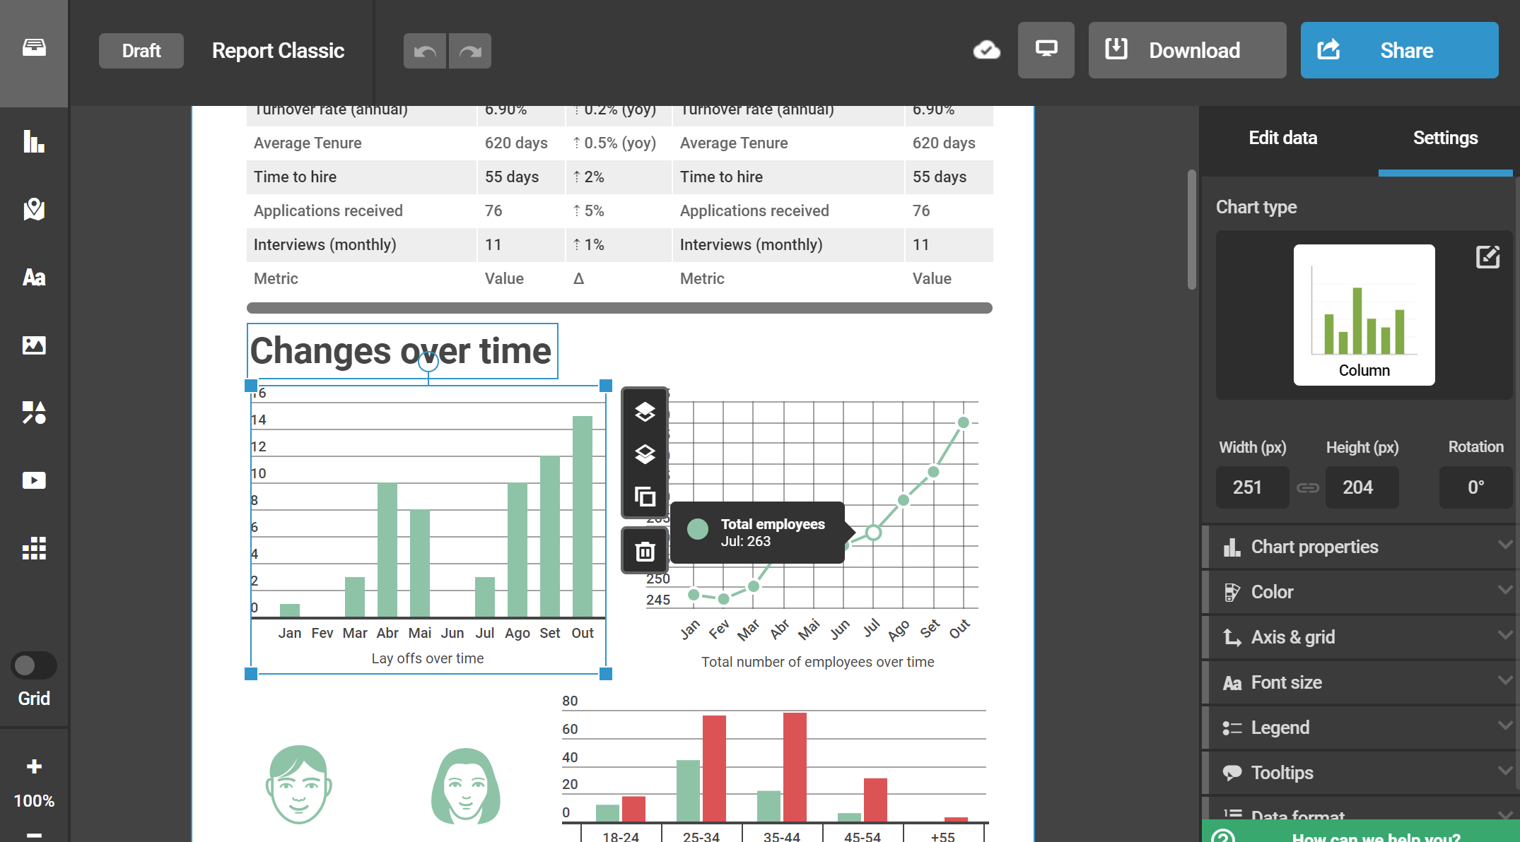
Let’s replace the example data with ours..

Slide 14
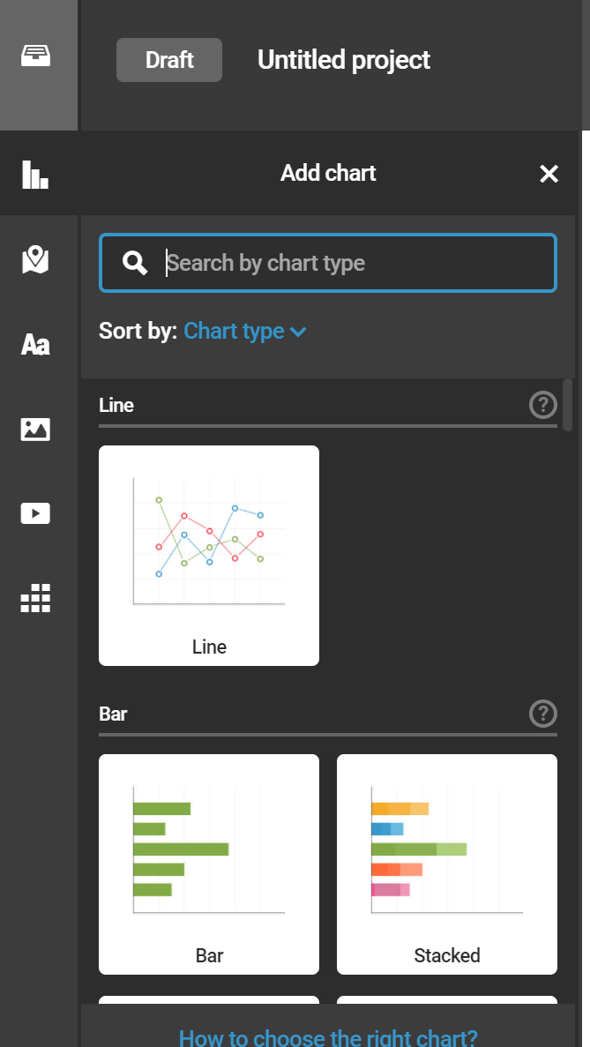
Add a graph

Slide 15
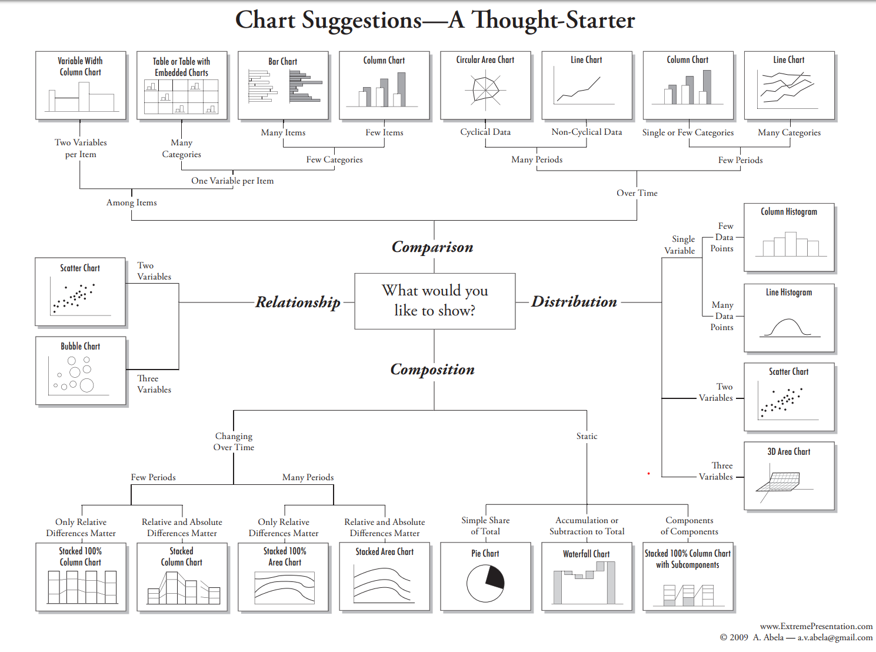
What kind of chart?

Slide 16
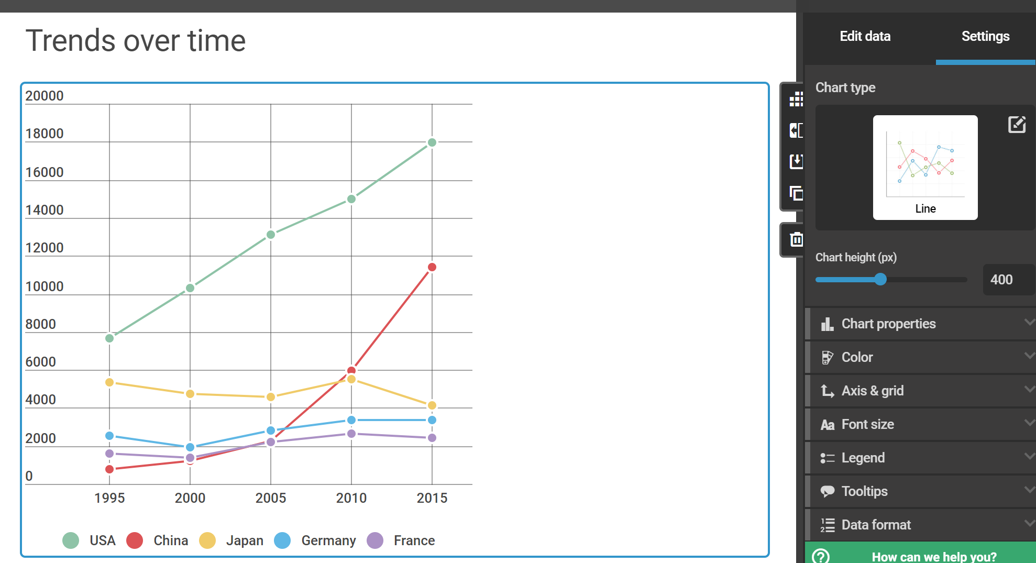
Let’s edit

Slide 17
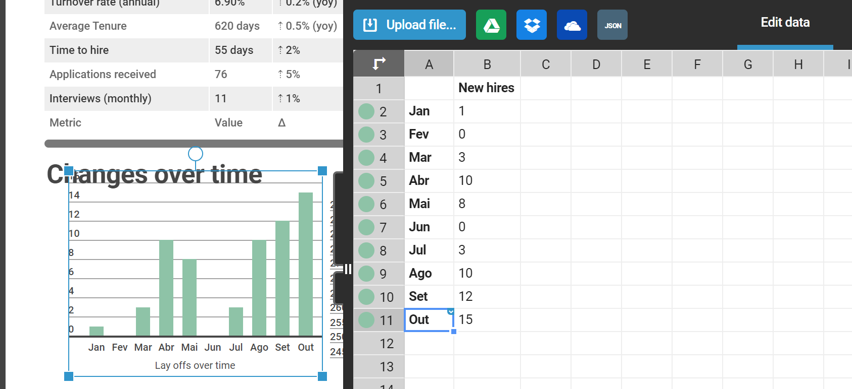
Edit data….or upload

Slide 18
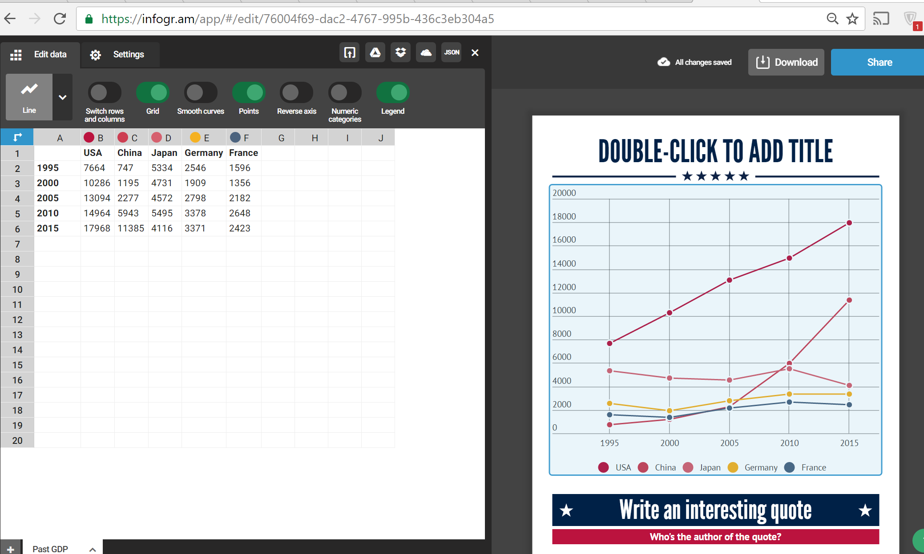
Let’s upload our data

Slide 19

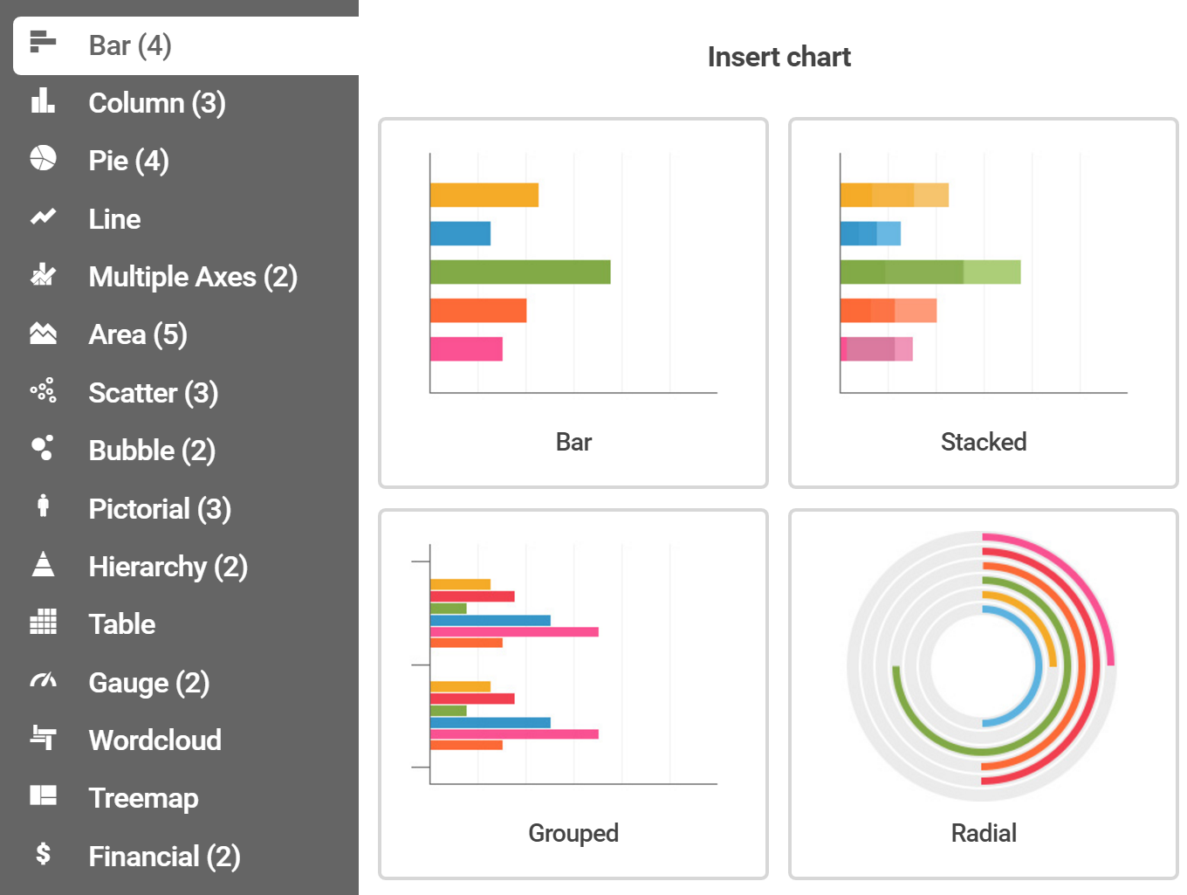
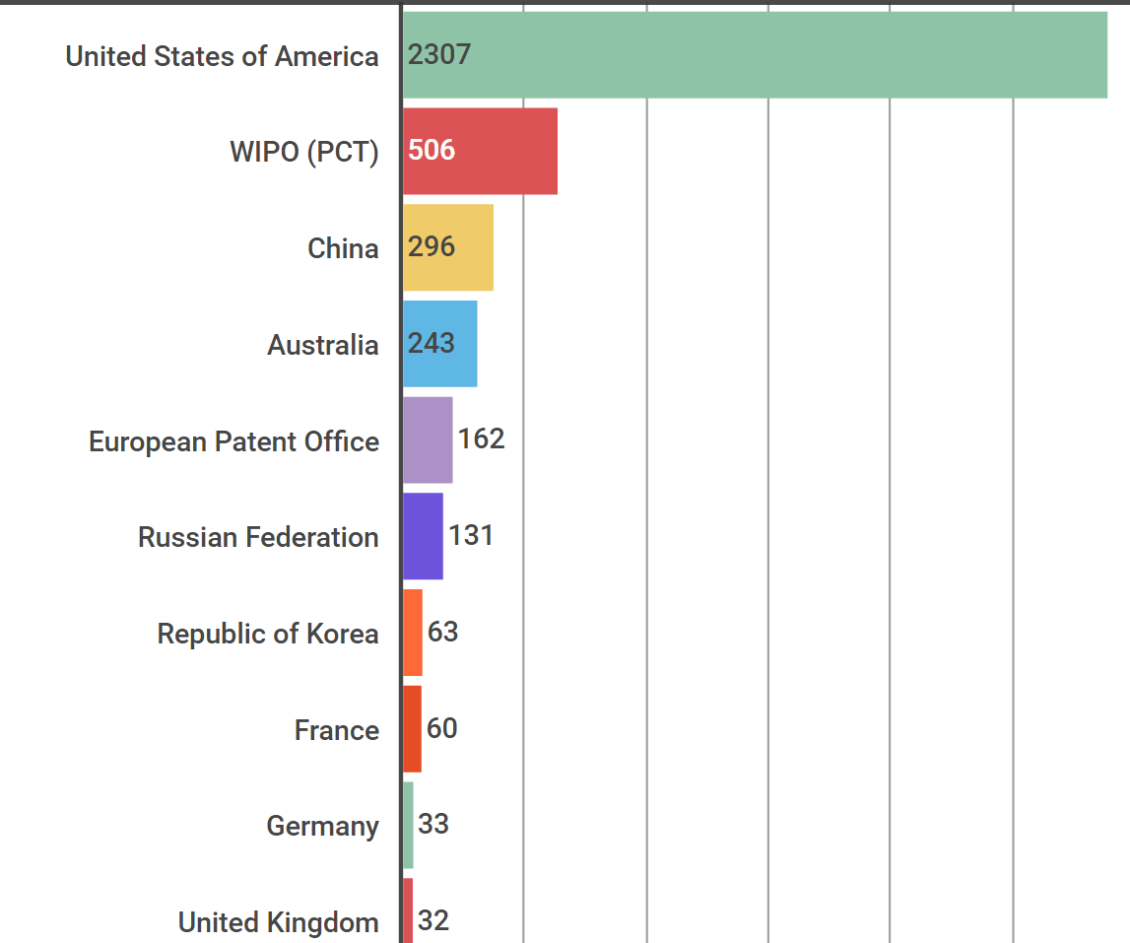
Let’s add a bar chart on

Slide 20
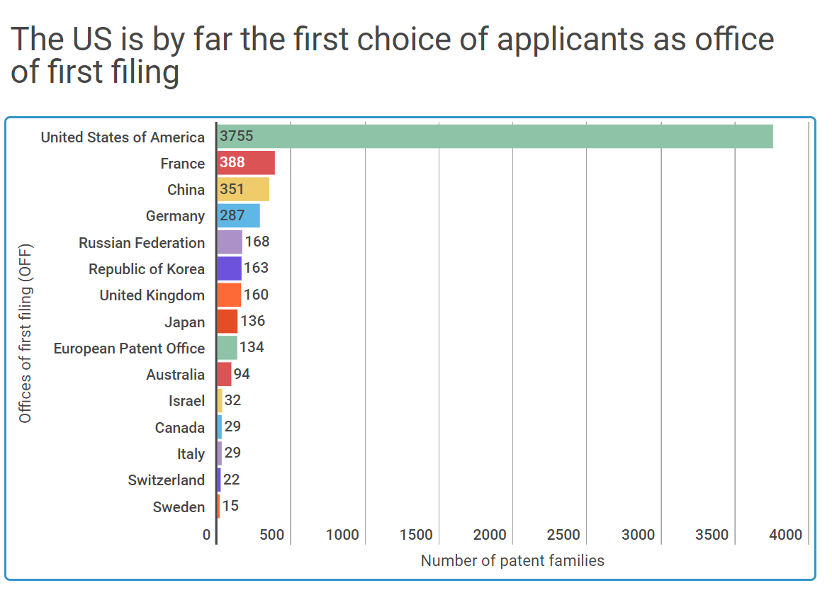
Bar chart - Priority countries

Slide 21
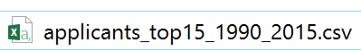
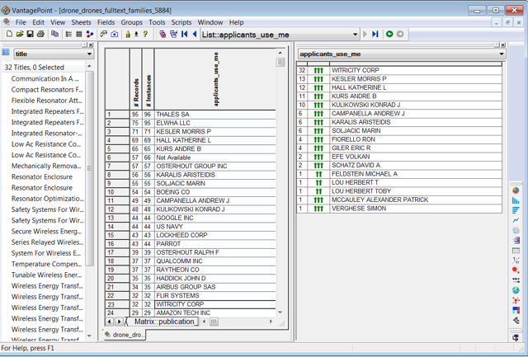
Let’s add the top applicants
… some important points we may be missing….
And how Gephi can help…

Slide 22
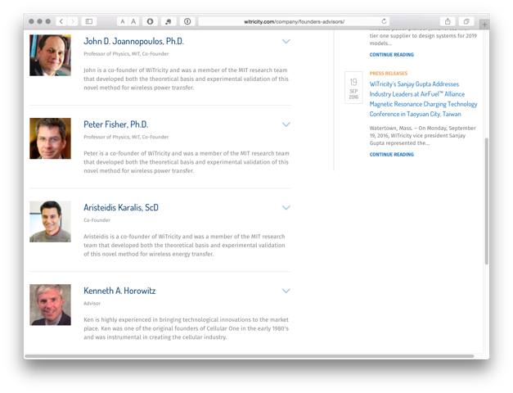
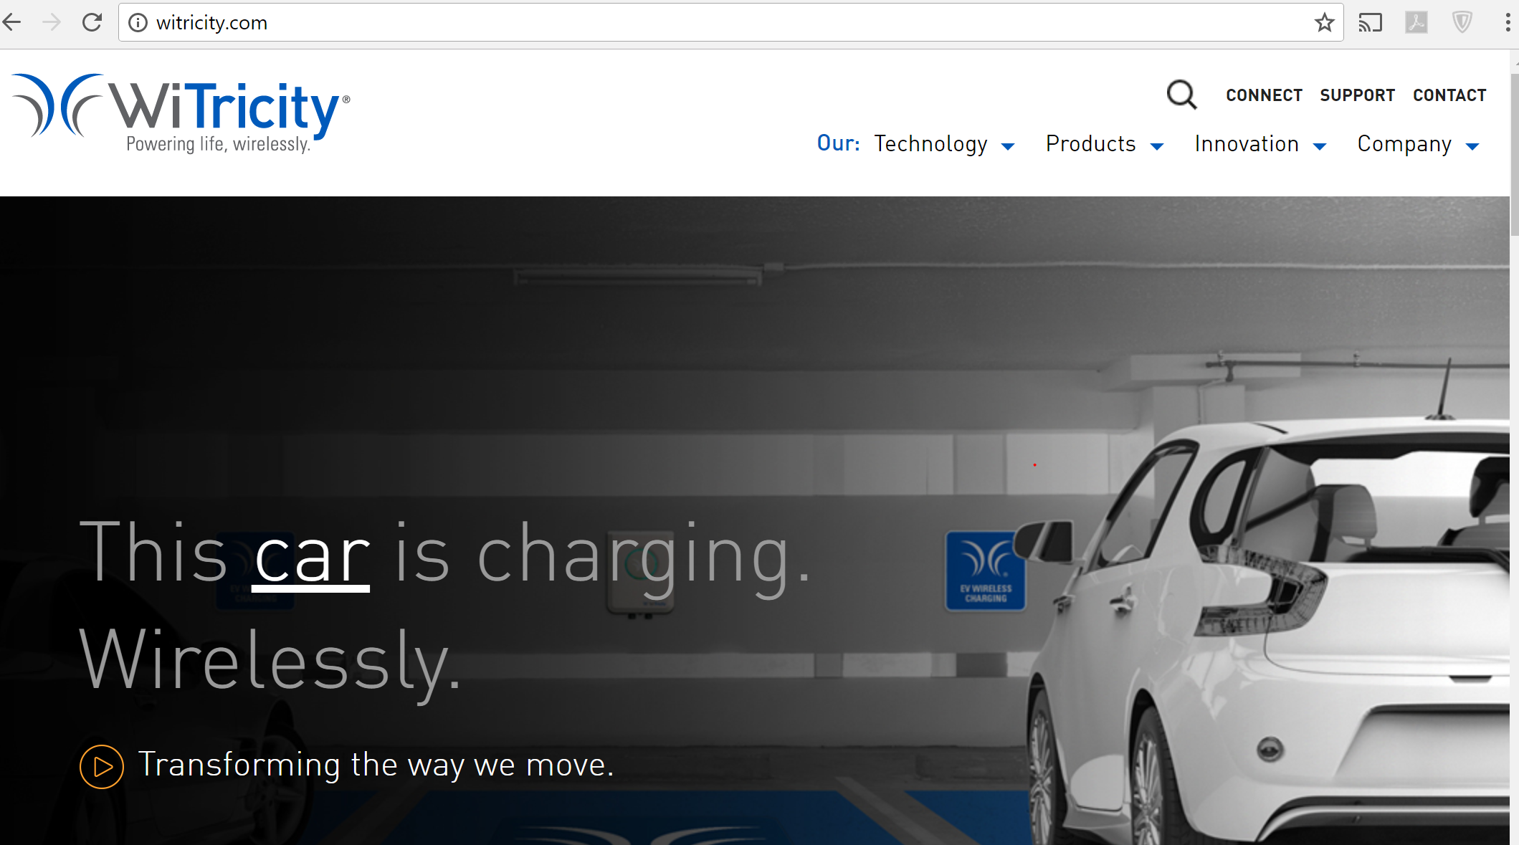

What does Witricity’s website tell us?
MIT Professor Marin Soljačić & his team: Peter Fischer, Aristeidis Karalis, Andre Kurs…

Slide 23
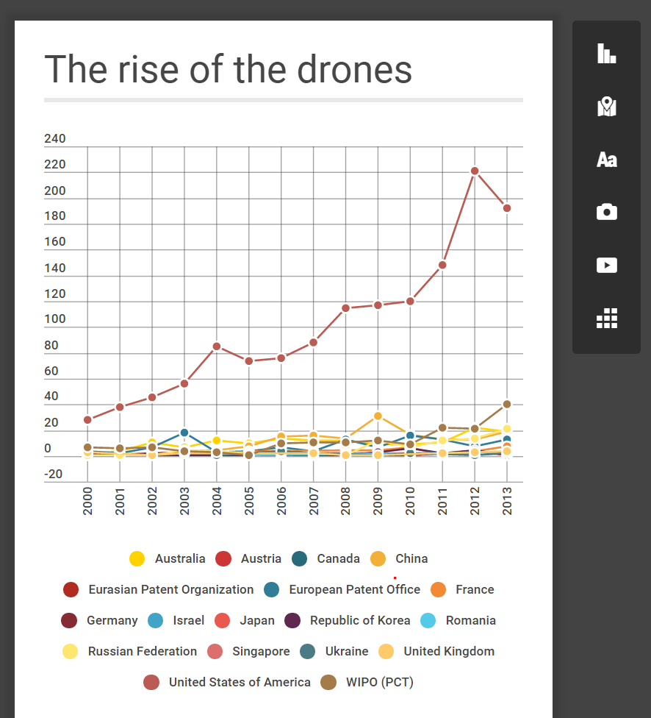
Add a title…and a picture

Slide 24
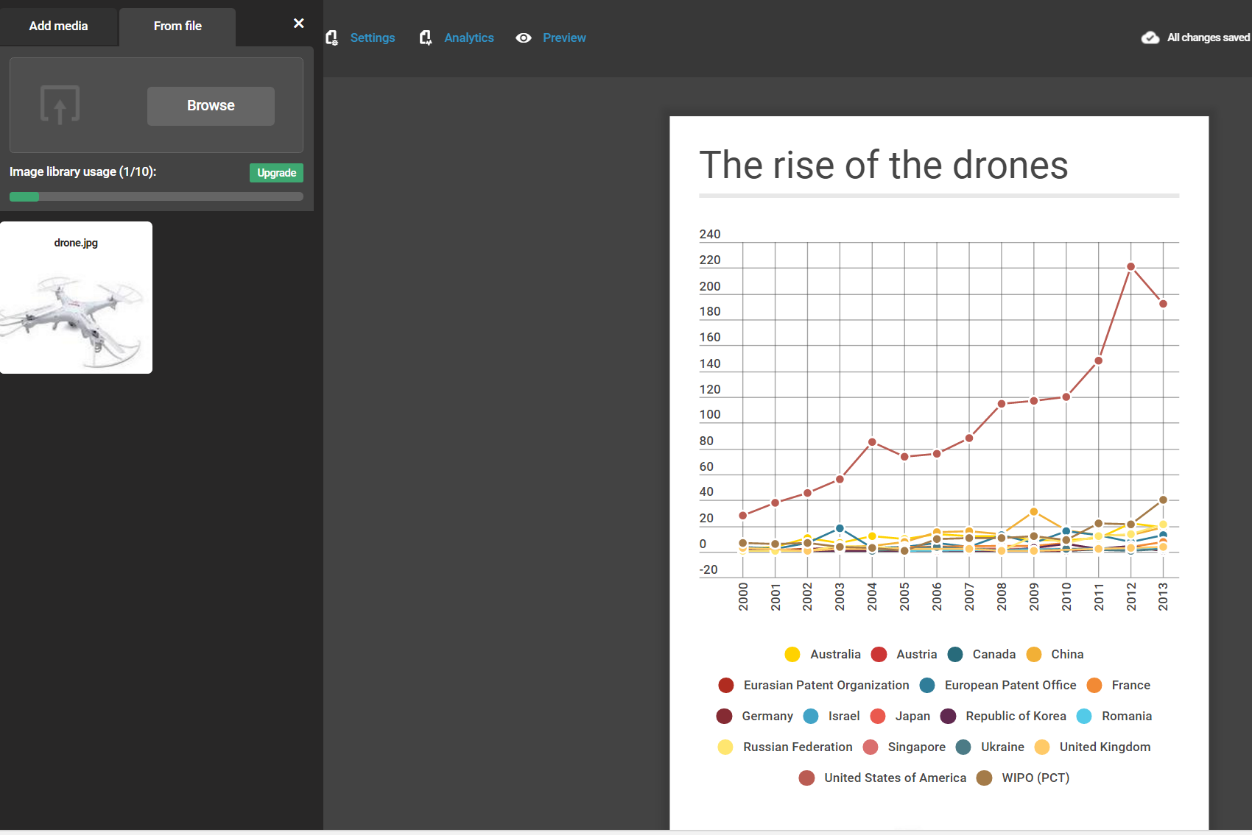
Select and position your picture on the infographic

Slide 25
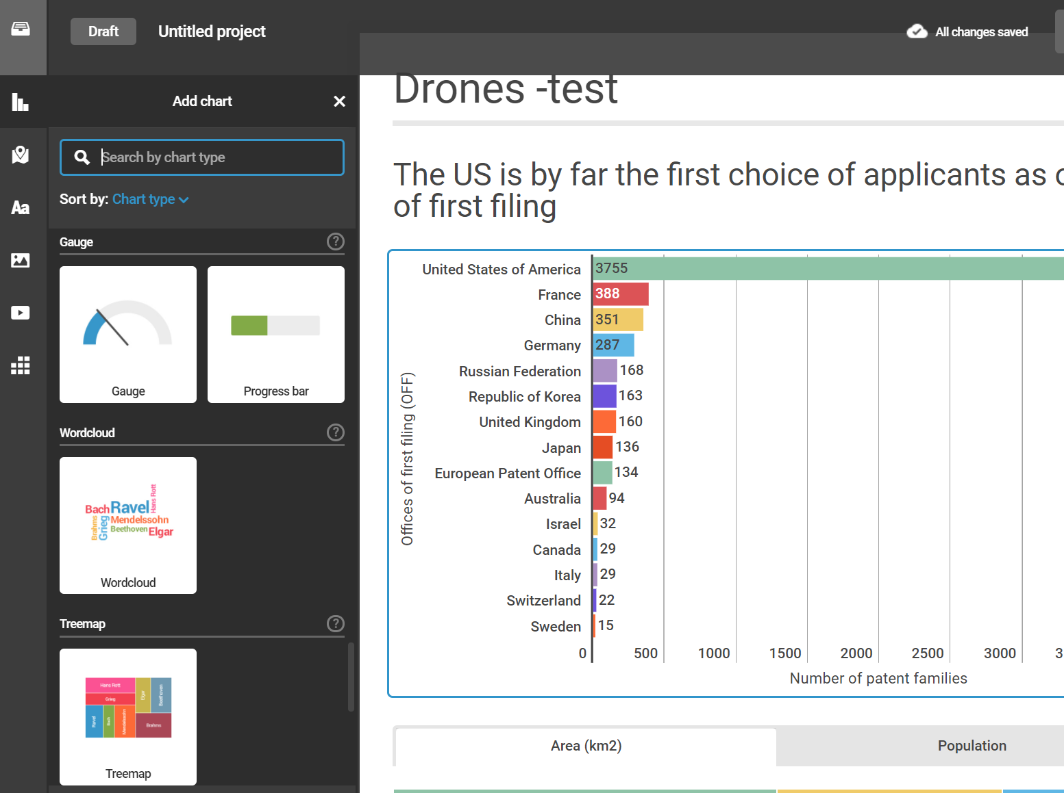
Which are the key concepts used in the drones dataset? – wordclouds and treemaps

Slide 26
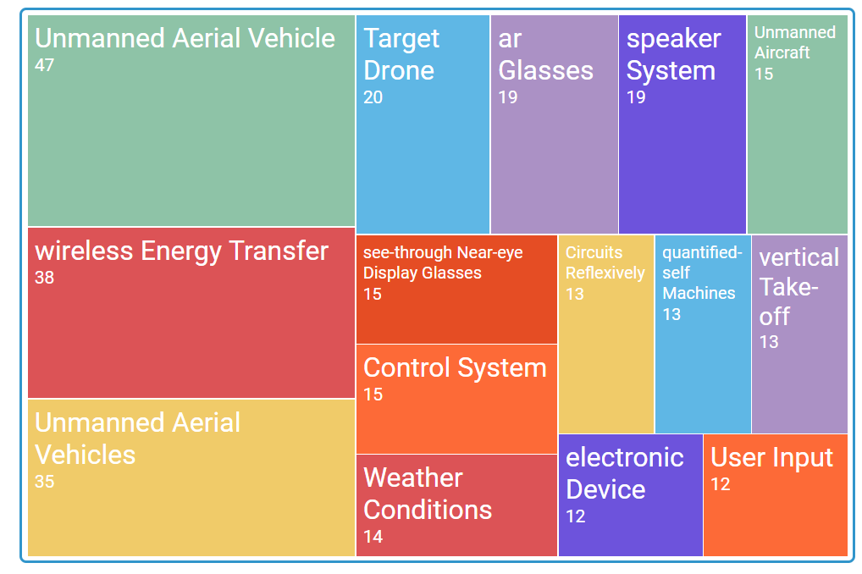
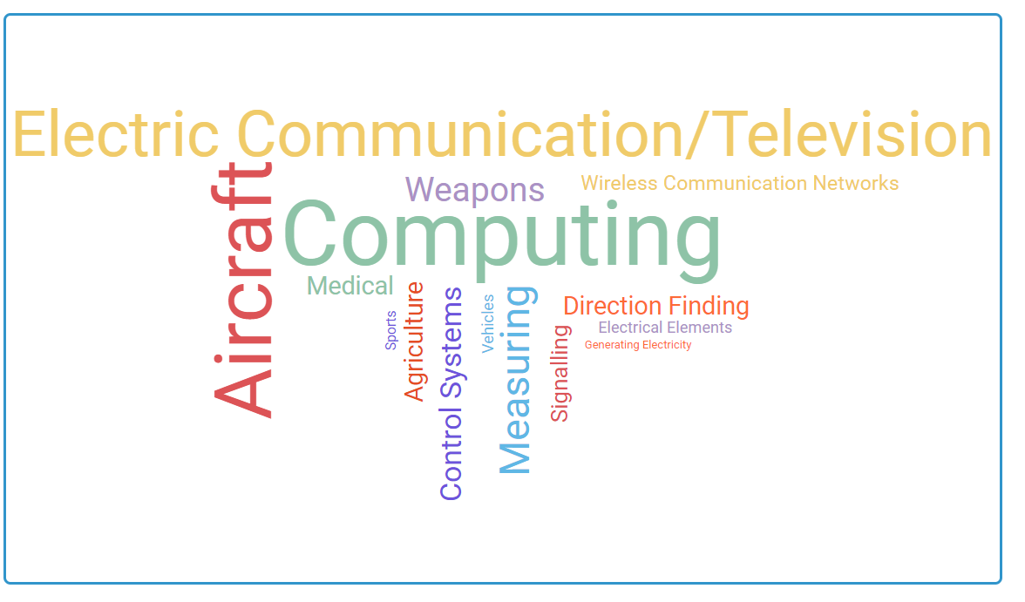
Treemaps and wordclouds

Slide 27
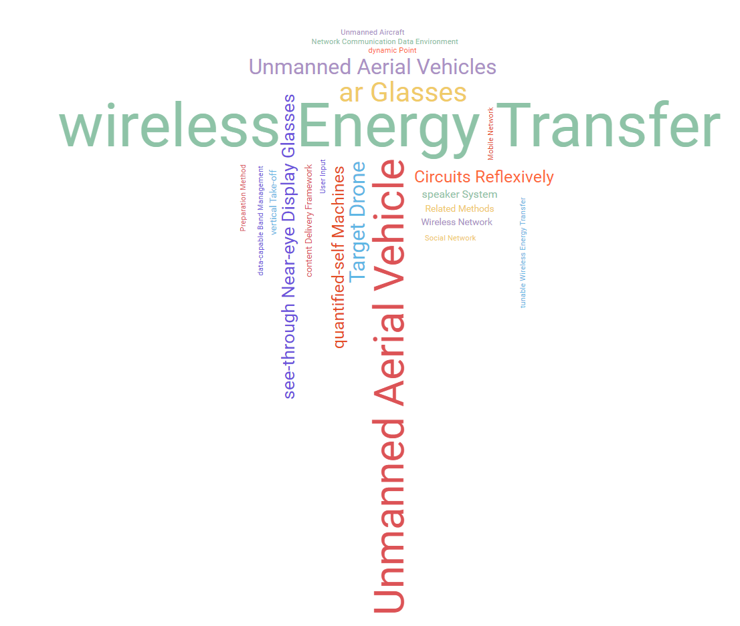

Slide 28
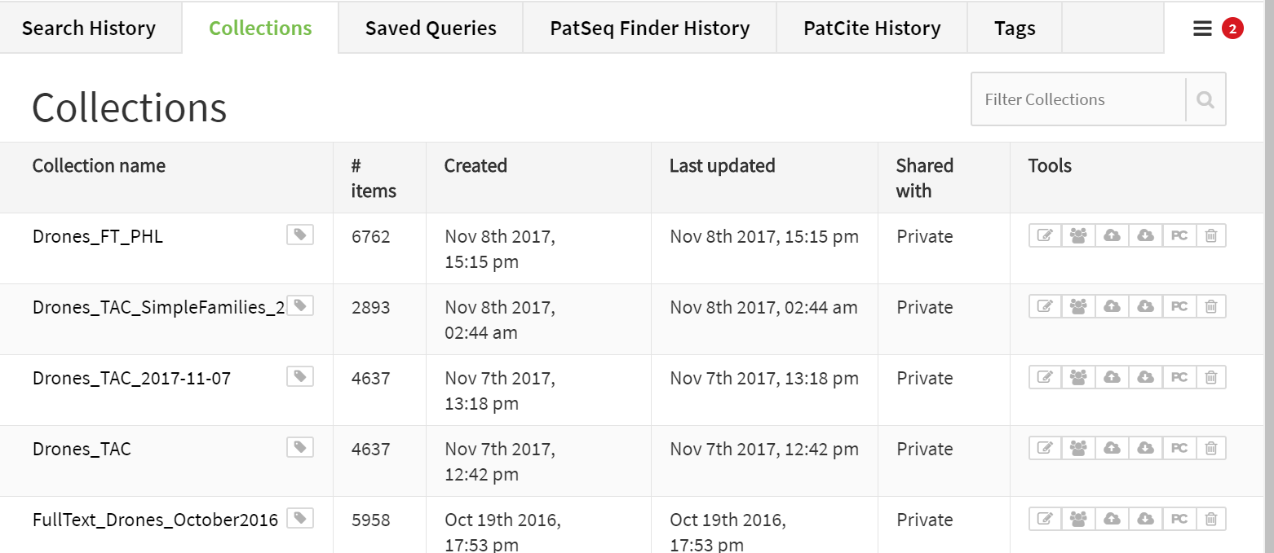
Let’s add a link to the dataset – remember Lens?
https://www.lens.org/lens/collection/12372
Note: remember to make the collection available to the public (the ones having the link)
Copy the link

Slide 29
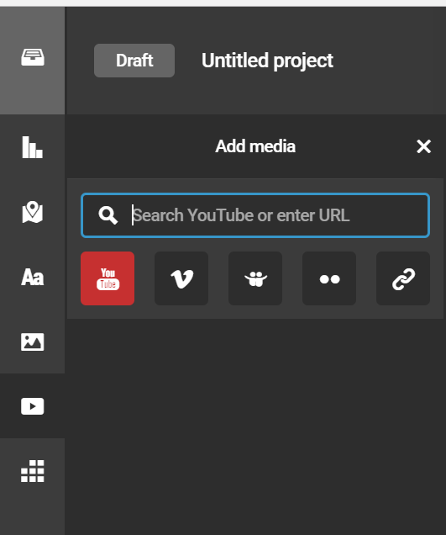
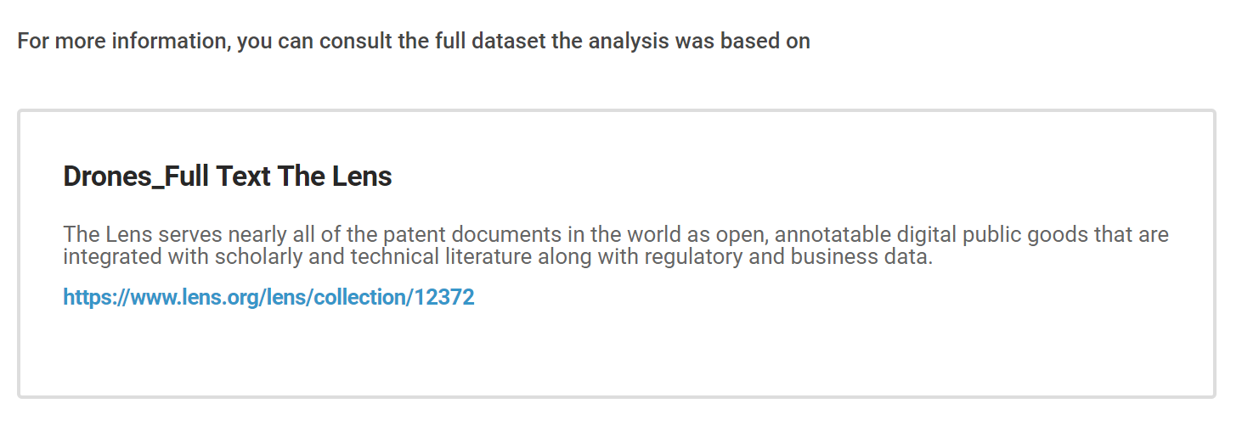
Add a link on Instagr.am
https://www.lens.org/lens/collection/12372

Slide 30
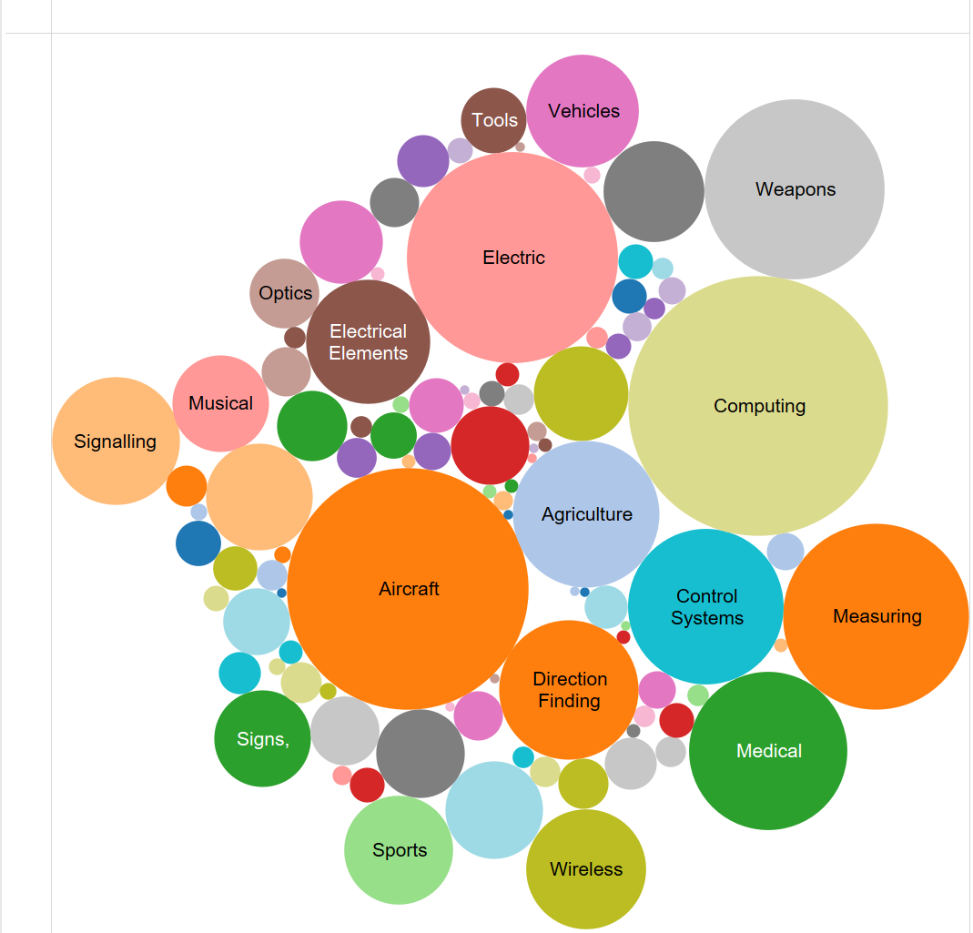
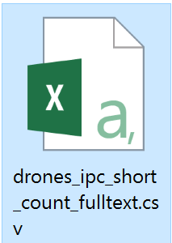
Adding a visualization on technology areas on the Infographic – remember Tableau? ;) – part I
Open Tableau
Choose a new data source
Select

Slide 31

Now: - download the visualization -(or just crop&save it) -import the image in the infographic

Slide 32

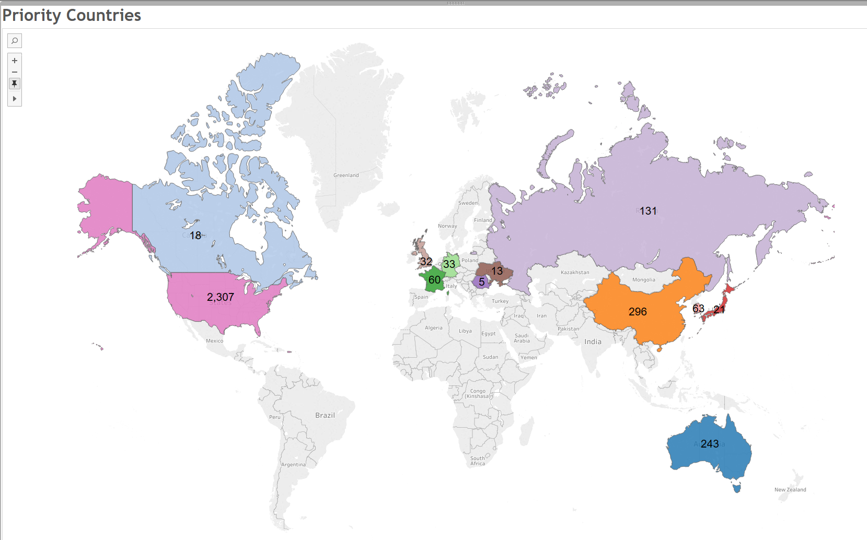
Adding a map on the Infographic – remember Tableau? ;) – part II

Slide 33
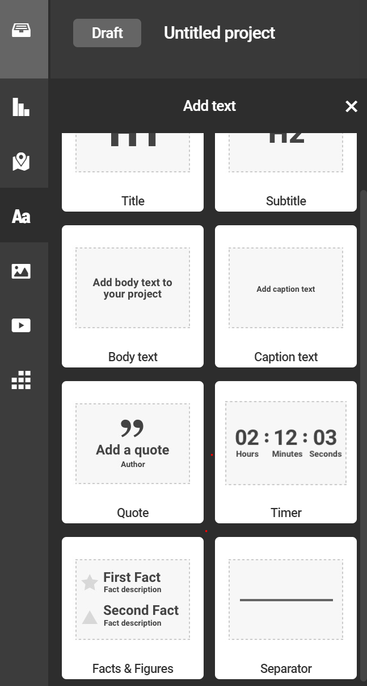
Adding Facts&Figures

Slide 34
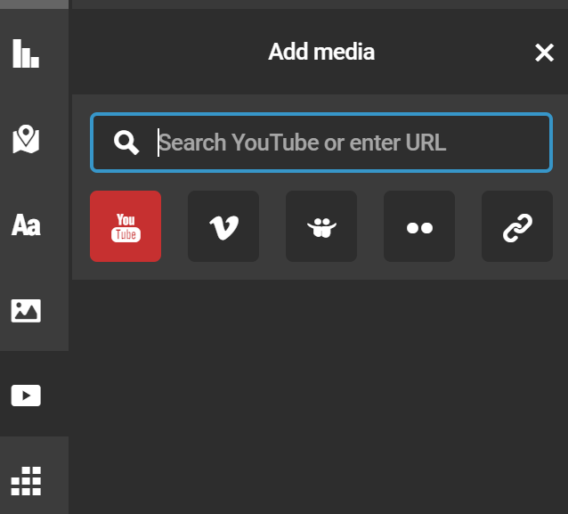
Let’s embed a video
https://www.youtube.com/watch?v=ZDXuGQRpvs4

Slide 35
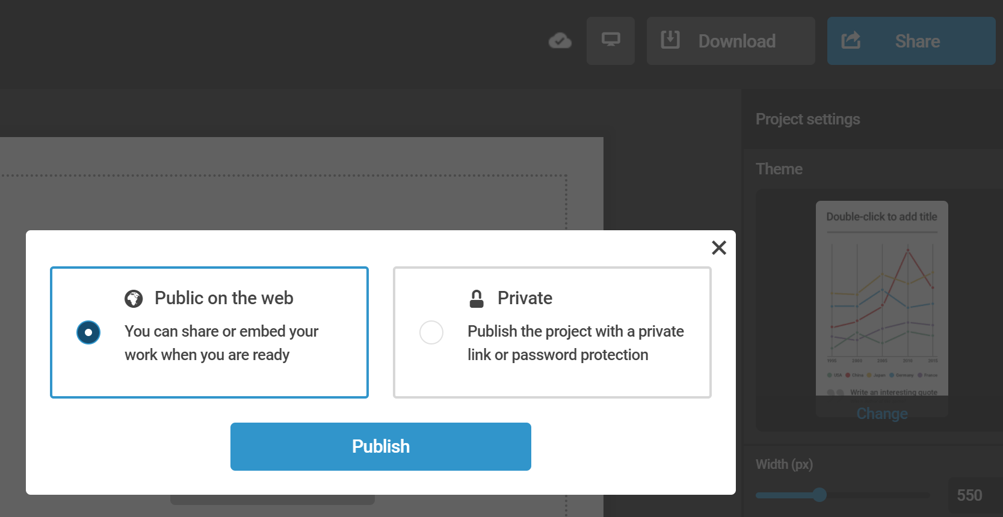
Now share your Infographic!
A drone example:
https://infogr.am/1e56252f-7463-4ff2-93bf-37955f73f9b3

Slide 36
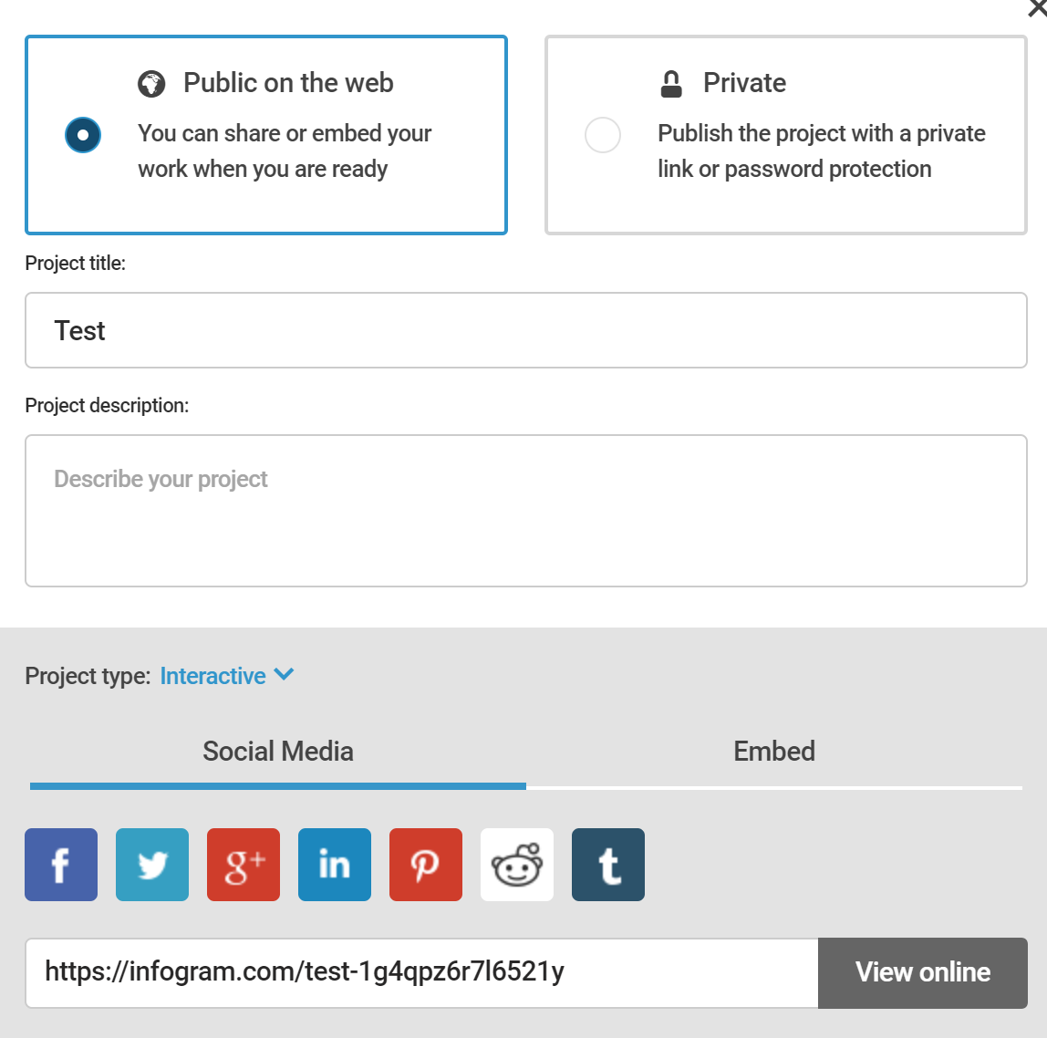
Share by link, social media or embed it on your website

Slide 37
Just keep practicing! Questions? Comments? Irene.Kitsara@wipo.int

